Slide 2
GREEN GRASSY SHOOT DISEASES.
AUTHOR:-
Mr. GHULAM AKBER, G.M ( C )
Mr. Mohsin Rafique , DCM
AL-ABBAS SUGAR MILLS LTD.
Sugarcane is the major source of both white and brown sugar in the world. It is grown on large area in different regions of the world. Sugarcane yield in our country is mostly affected by pests and diseases. Nowadays, a severe disease is observed in central Sindh. The disease has been spread over about 2500 acres. The exact name/ profile have not been traced, name given on the basis of sign/ symptoms as “GREEN GRASSY SHOOT DISEASE”. General observation reports that Ratoon crop have higher percentage of the disease. This is high time for inviting research institutes and pathologists of the country to minutely examine this diseases & find out reasons of its occurrence and suggest subsequent measures to control this fatal disease at its early stage.

Slide 3
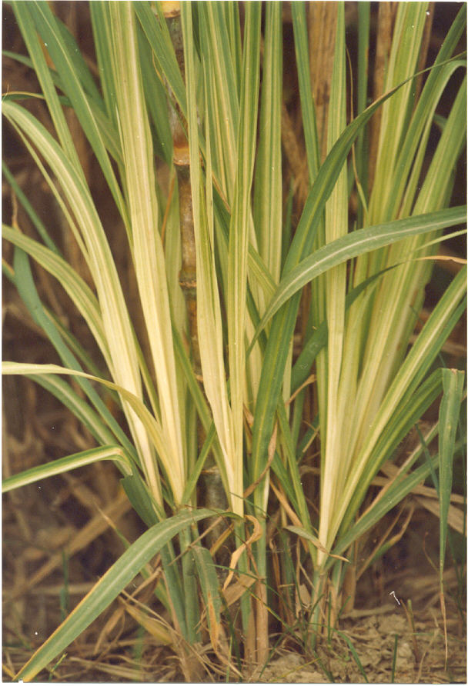
The Outlook of
Grassy shoot of Sugarcane diseases

Slide 4
INTRODUCTION
Effected Pathogen : - Phytoplasma (Reportedly)
Host of Disease : - Sugarcane
Carrier of Disease : - Aphid & leaf hopper etc.
A vital sign of sugarcane plant ailment includes rapid generation of new tillers around the root of bunch, resultantly the top leaf coulor becomes white or creamy yellow and growth of main plant stopped and reduced significantly. Grassy shoot disease is a viral disease, this disease caused by phytoplasma virus infested on phloem tissue of the sugarcane and affecting the sugarcane crop through out its crop growth stages.

Slide 5
SYMPTOMS OF DISEASE.
Infested sugarcane plant show a proliferation of tillers which give it typical grassy appearance, the leaves of plants appear bushy and grass like due to the reduction in internodes premature and continues tillering , the leaf of infested plants do not produce chlorophyll therefore appear white or creamy. Effected plant does not produce Mill able cane, the diseases particularly pronounce in the ratoon crop. It is more severe in ratoon crop.
Sugarcane is vegetatively propagated crop so the pathogen is transmitted through seed sets planting material and by flowing feeding vector as aphids. And leaf hopper etc.

Slide 6
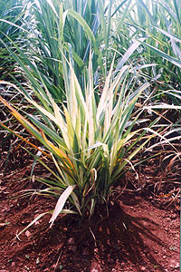

Slide 7
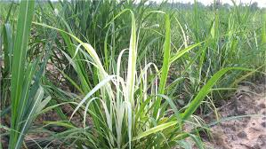

Slide 8
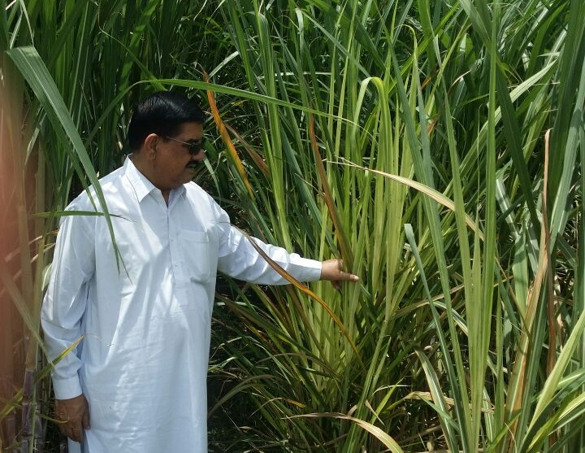

Slide 9
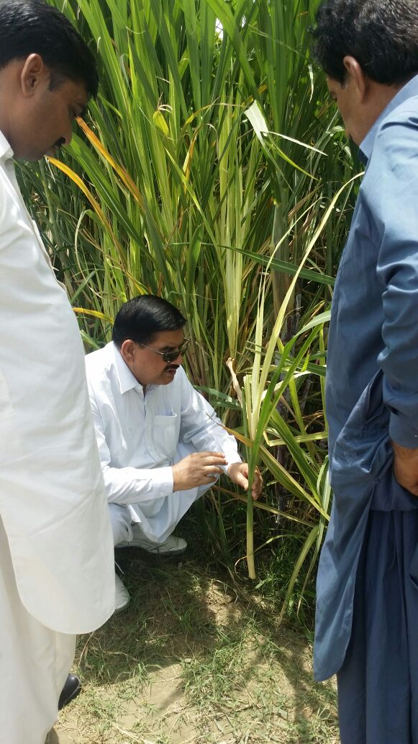

Slide 10
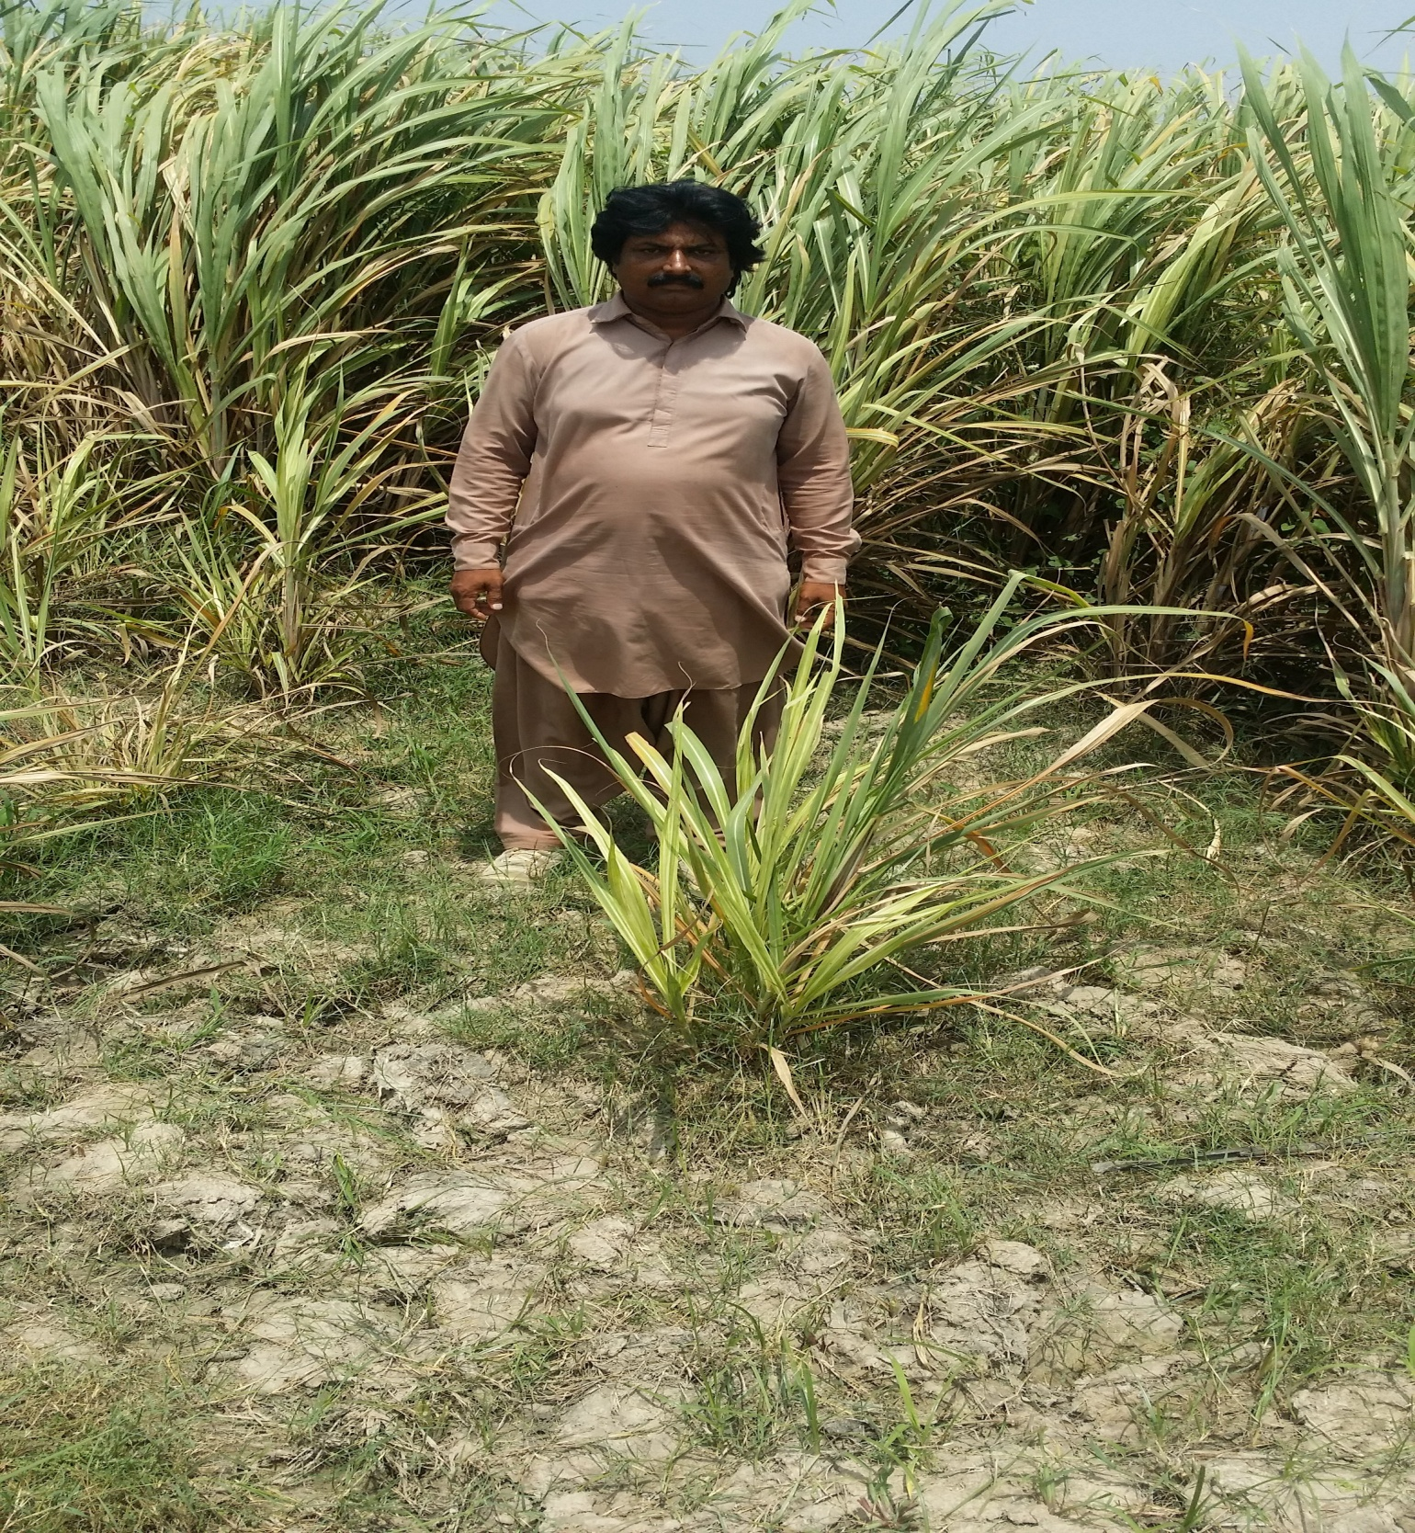

Slide 11
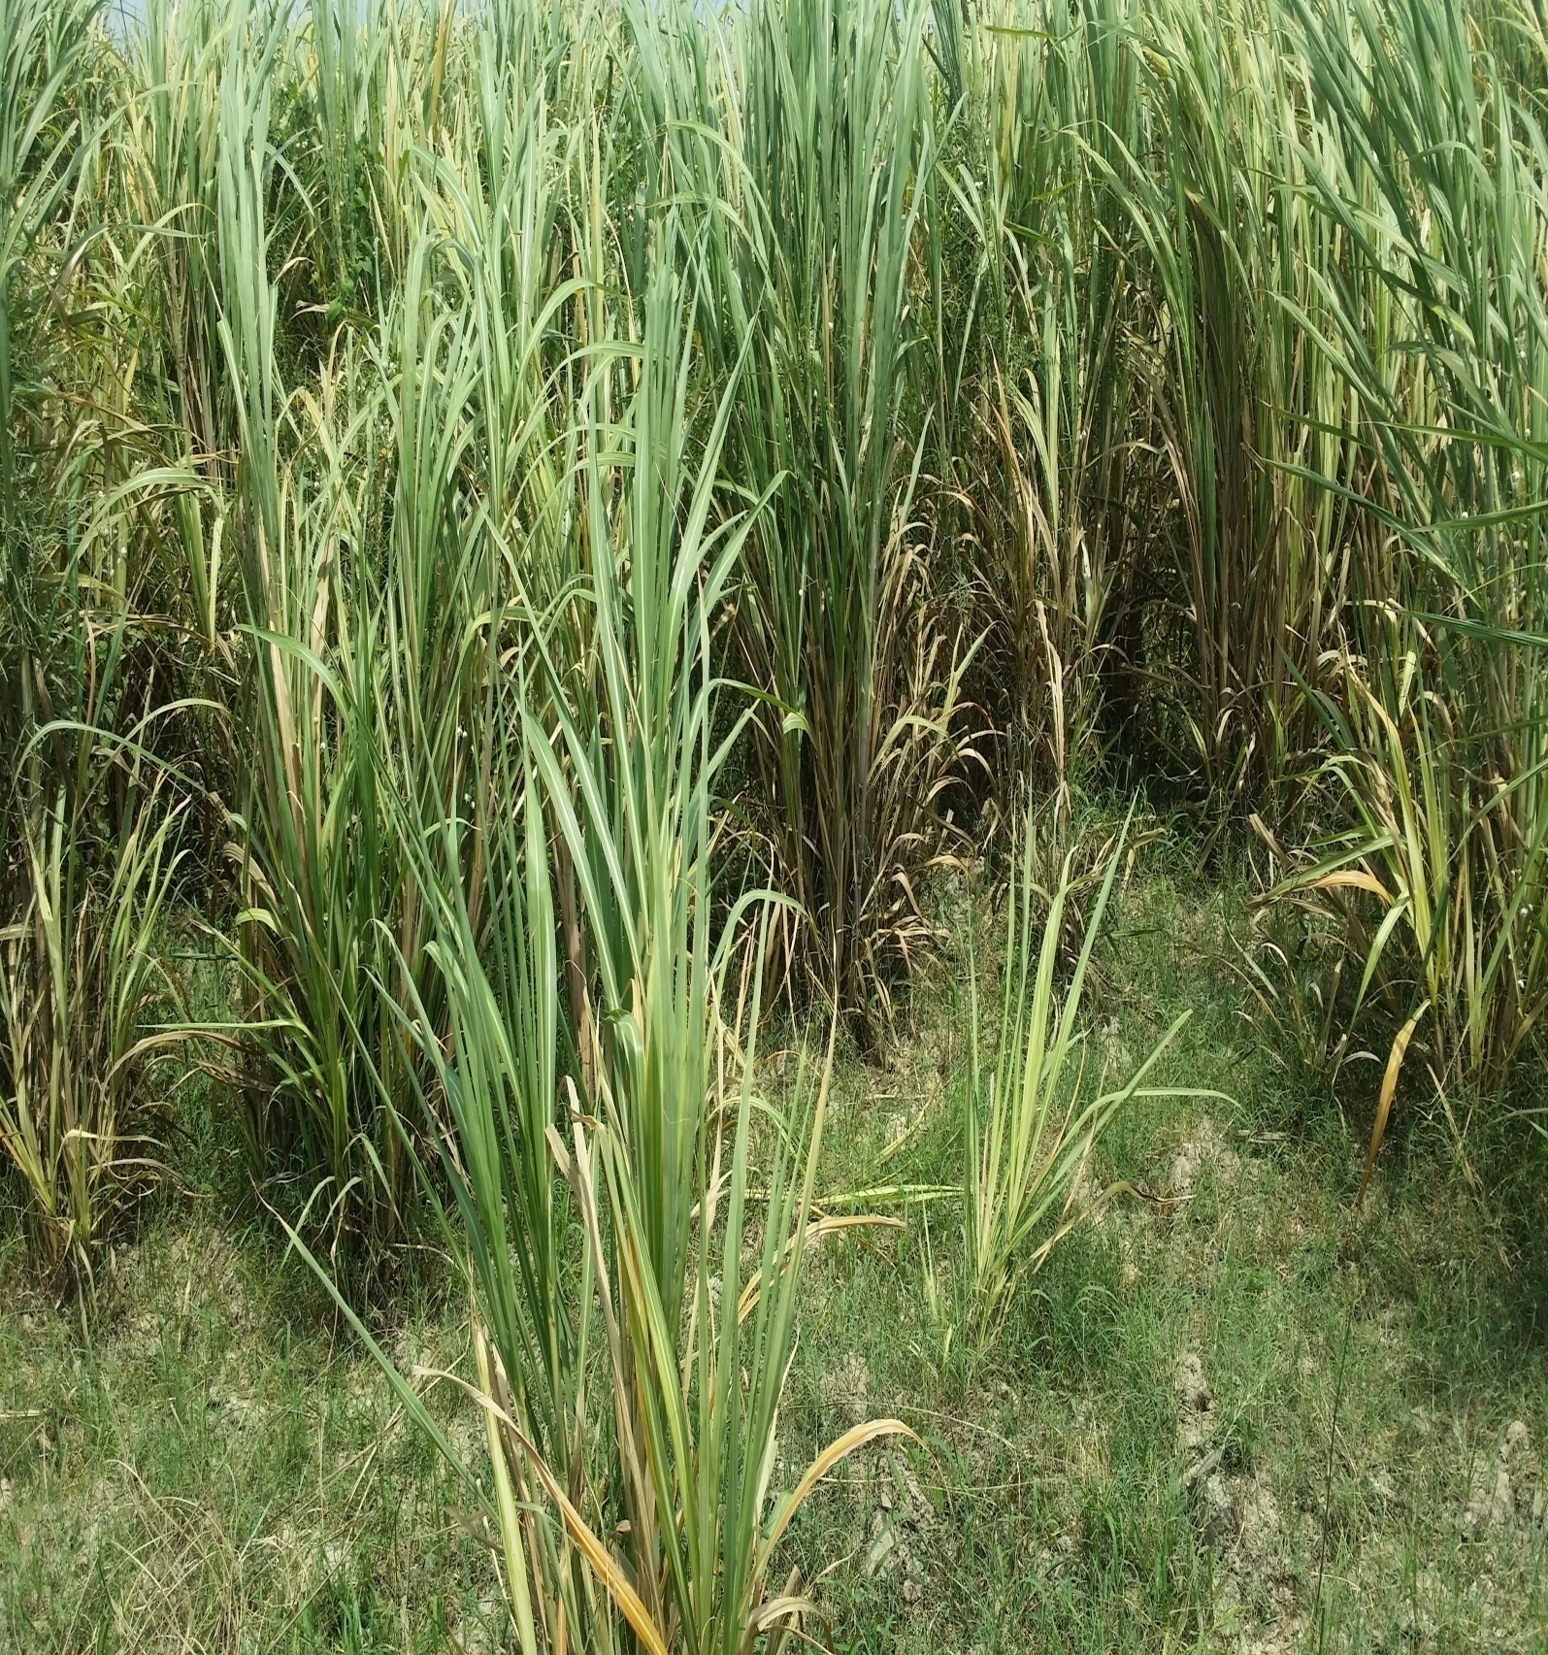

Slide 12
MANAGEMENT
Phytoplasma virus also spread through insect vectors it is therefore important to control them.
Use the disease free, healthy seeds
Hot water treatment of setts at 52˚ C for 30 minutes.
Treat the seed with fungicide ( Topsin, Benlet, Egglol ,Antimucine, Artiyan etc)
Seed should take from plant crop (Autumn or Spring ) not from ratoon.
5. HSF-240 variety has been more effected by this disease as compare to the other varieties so avoid for new cultivation of this variety.
6. Remove infested plant along with root and should be buried.
Avoid the ratoon in the problem areas & not cultivate sugarcane in same effected area.
Leave the gap between effected area for cultivation the new crop.

Slide 13
RECOMMENDATIONS & SUGGESTIONS.
1. This is a severe disease and not easily treat. The scientist should take measures on war footing basis to control this disease.
2. The growers/ Mills staff visit the field regularly and check thoroughly if any effected plant seen in the field, plant should be taken out along with roots and buried immediately.
3. Seed should be avoided from effected field.
4. Effected Ratoon crop should be avoided by growers and Mills have to aware them.
5. The Extension Department should also aware to growers about this disease.
6. The Government/ Mills should approach the National & International research institutes to find out the reasons of its occurrence and suggest measures to control this fatal disease at its early stage.
If Mills and Government should not take an early steps for the control of this disease , in future sugarcane industry may suffer on large scale.
THANKS.

